Slide 1

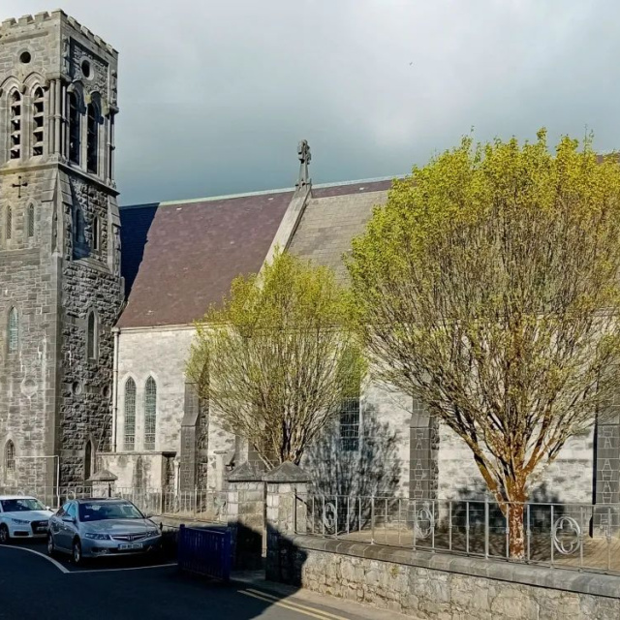
The Art of Mick O’Dea
Meet the famous painter from Ennis, County Clare.

Slide 2

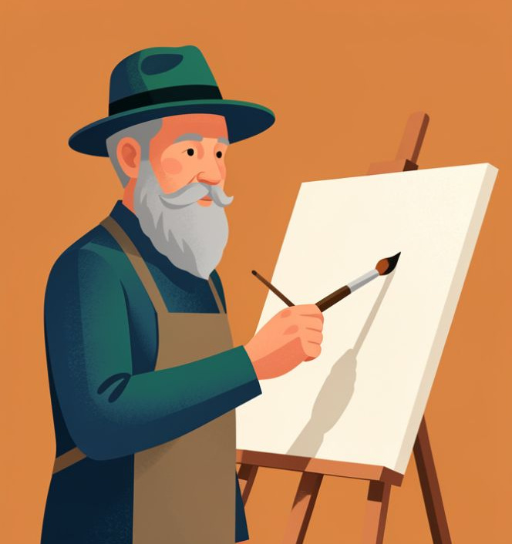
Who is Mick O’Dea?
Imagine meeting a local hero!
Have you ever wondered who paints the portraits of famous Irish people? Mick O’Dea was born in Ennis in 1958. He is one of Ireland's most famous living artists.
🤯
Fun fact
Mick loved drawing so much as a boy that he eventually became the President of the Royal Hibernian Academy, a very important art group!

Slide 3
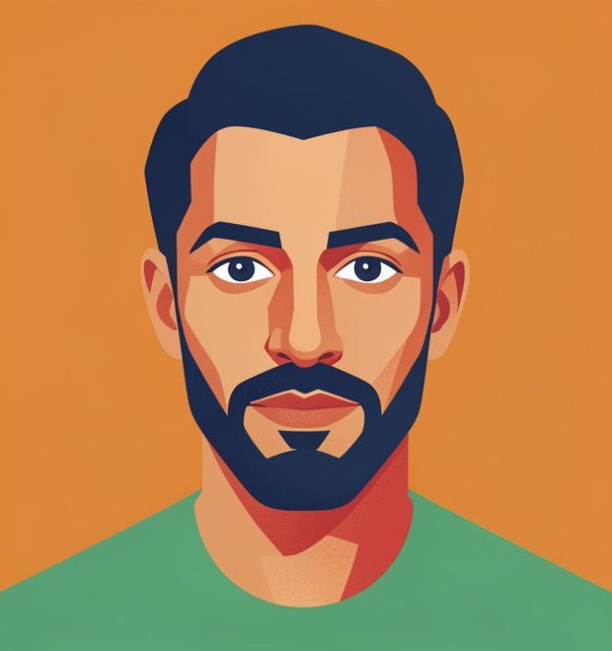
Portraits: People and Stories
Mick is known for his portraits. A portrait is a painting of a person. He paints how they look and their personality.
Real Life - He paints people from his own life or famous Irish leaders.
Feelings - He uses colors to show if a person is happy, serious, or thoughtful.

Slide 4
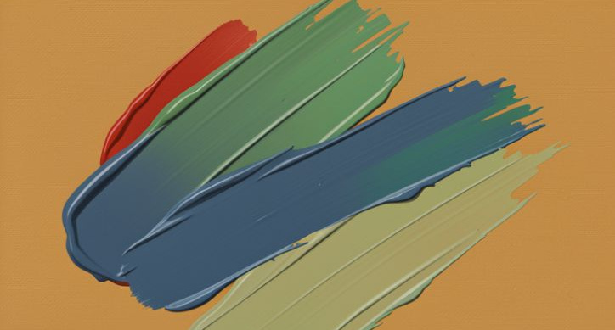
His Unique Style
Mick’s style is easy to spot. He uses lots of paint and bold choices.
Thick Paint
He uses impasto, where paint is thick like cake frosting!
Bold Lines
He uses strong lines to make figures pop from the background.
🧠
Remember
If you touched his work, you would feel the paint's texture.

Slide 5
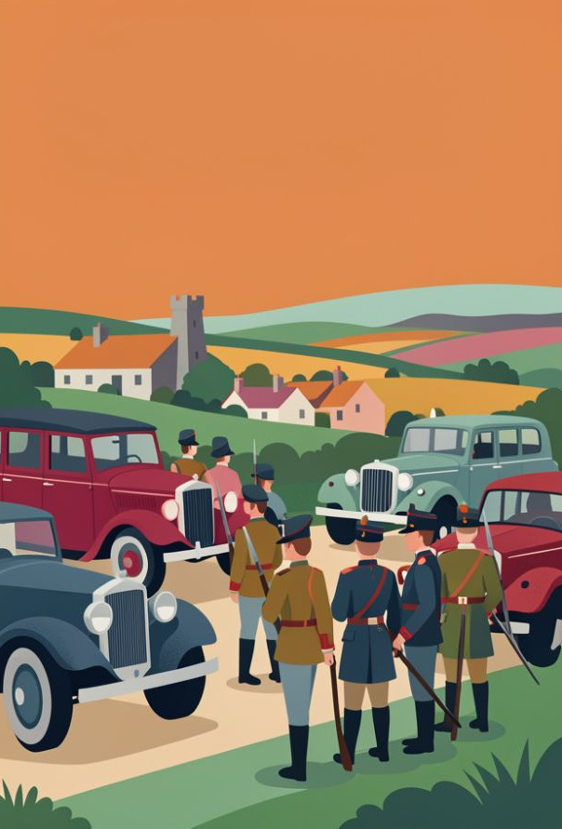
Painting History
Mick is also very interested in the past. He created a famous series of paintings about the Irish War of Independence.
He looked at old black-and-white photos from 100 years ago and turned them into giant, colorful paintings to bring history to life.

Slide 6

A Visit to the Gallery
Listen to the audio and answer the questions
Kids discuss Mick O’Dea’s art
▶ Play audio
1
Where is Mick O’Dea from?
2
What is the name for the 'thick paint' style Sean noticed?
3
What does Mick use to help him paint historical scenes?
4
What two things is Mick O’Dea famous for wearing?
Answers on the next slide...

Slide 7
A Visit to the Gallery
✅​
Check your answers below
Kids discuss Mick O’Dea’s art
▶ Play audio
1
Ennis (in County Clare).
2
Impasto.
3
Old photographs.
4
A hat and his beard.

Slide 8
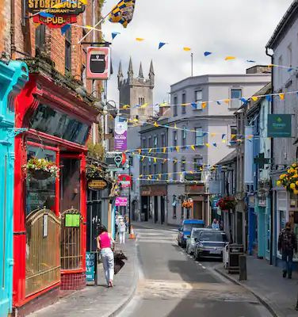
Capturing the Moment
Mick doesn't just paint in a studio. Sometimes he paints en plein air. This is a French phrase that means painting 'in the open air'.
🔍
Example
He might stand on a street in Ennis with his easel and capture the people walking by or the way the light hits the shops.

Slide 9


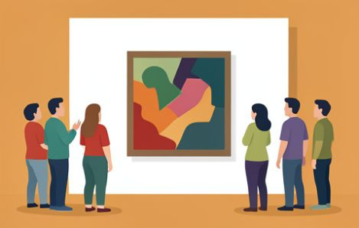
Why Artists Matter
Artists like Mick O’Dea help us see our world in a new way. They are like historians using brushes instead of pens.
Observe - They look closely at the world.
Feelings - They add their own emotions.
Share - They show us their vision.

Slide 10
Art Words Check
1.
En Plein Air
a)
The main person or thing in a painting.
2.
Subject
b)
Applying paint very thickly.
3.
Impasto
c)
Painting outdoors, on location.
4.
Portrait
d)
A painting of a person.

Slide 11
Art Words Check
✅​
1.
En Plein Air
c)
Painting outdoors, on location.
2.
Subject
a)
The main person or thing in a painting.
3.
Impasto
b)
Applying paint very thickly.
4.
Portrait
d)
A painting of a person.

Slide 12

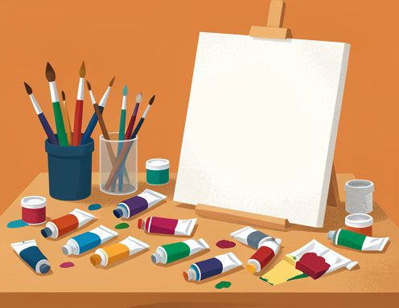
Your Turn to Paint!
If painting a family portrait, what colors show their personality? Would you use thick impasto or smooth paint?

Slide 13
Your Turn to Paint!
✅​
You might have said...
I would use bright yellow because my Mum is always happy.
I would use thick paint for my Grandpa because he is very strong.
I'd use blue and green for my sister because she is very calm.

