Slide 1
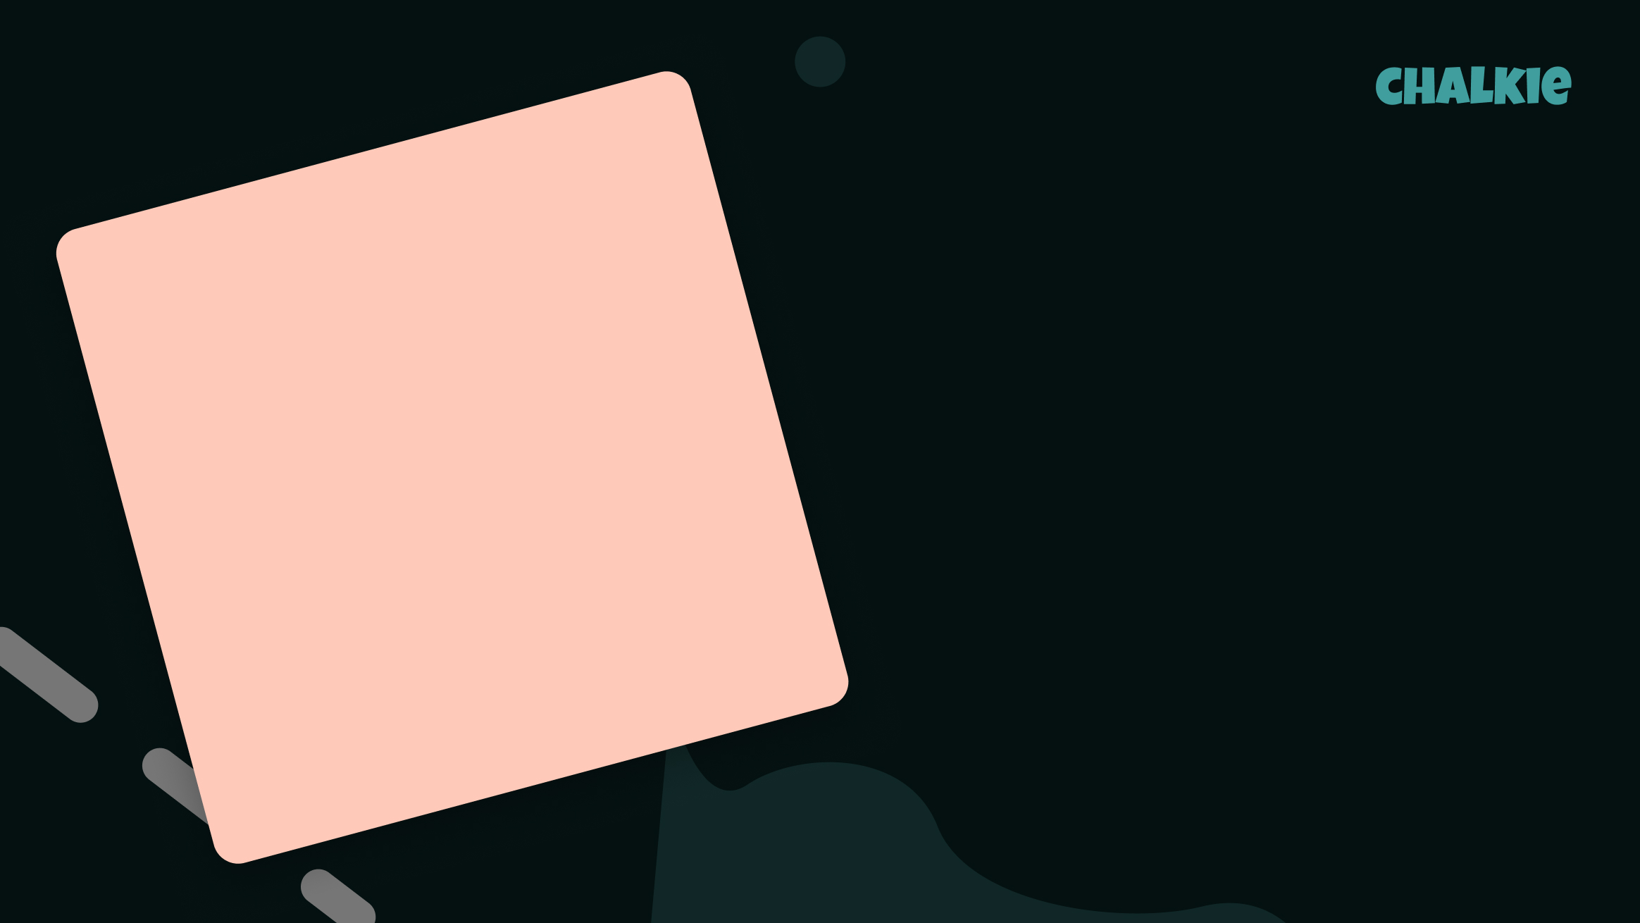

Graham Knuttel: The Artist of Shapes
Meet Ireland's most colourful and quirky painter!

Slide 2

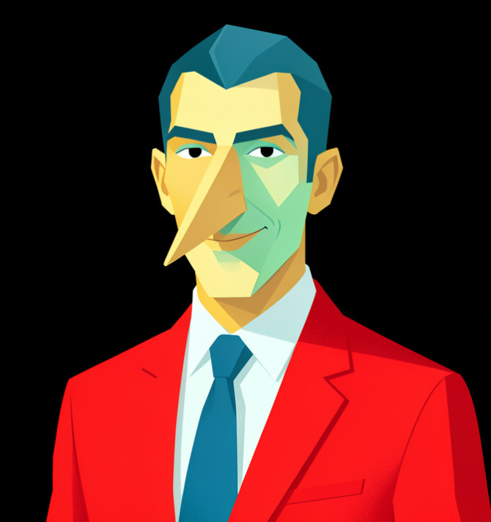
A Bold World
What do you see?
Imagine looking in a mirror that makes everything look like a puzzle piece. Would your face look like a circle or a square?
Graham Knuttel was an Irish artist who loved to paint people and animals in a very special way. He didn't want things to look 'real'—he wanted them to look bold and fun.

Slide 3
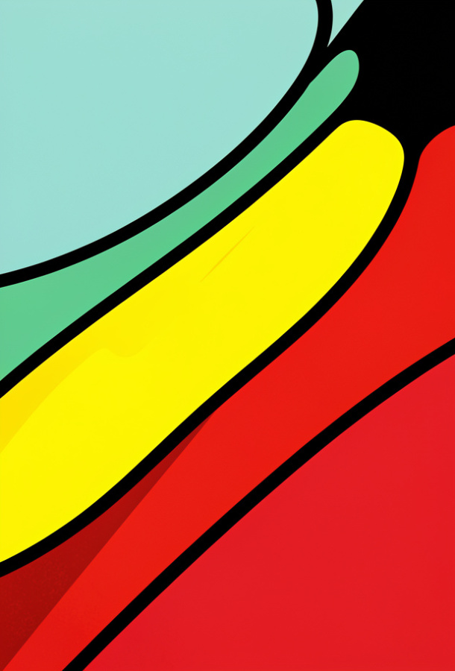
Lines and Colours
Knuttel's work is very easy to spot! He used:
Thick black outlines (like a comic book).
Bright, solid colours (reds, yellows, and deep blues).
Pointed shapes (sharp noses and pointy chins).
🤯
Fun fact
Graham Knuttel started as a sculptor, which means he used to make 3D art from wood and stone before he became a famous painter!

Slide 4
Knuttel Tool Kit
1.
Bold
a)
The black line around the edge of a shape.
2.
Quirky
b)
Strong, bright, and easy to see.
3.
Sculptor
c)
Something unusual and interesting in a fun way.
4.
Outline
d)
An artist who makes 3D art out of clay or stone.

Slide 5
Knuttel Tool Kit
✅​
1.
Bold
b)
Strong, bright, and easy to see.
2.
Quirky
c)
Something unusual and interesting in a fun way.
3.
Sculptor
d)
An artist who makes 3D art out of clay or stone.
4.
Outline
a)
The black line around the edge of a shape.

Slide 6
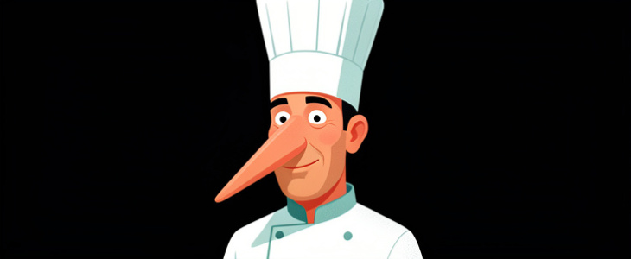
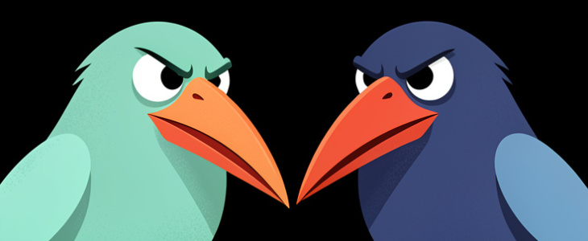
Famous Characters
Graham Knuttel loved painting characters like chefs, birds, and cafe-goers. Each character looks like they have a secret story to tell.
The People - His characters often have very long, sharp noses.
The Birds - He painted wide-eyed birds with huge beaks.

Slide 7

A Visit to the Gallery
Listen to the audio and answer the questions
Talking about Graham Knuttel's Art
▶ Play audio
1
Where was Graham Knuttel born?
2
What kind of lines did Siobhan say the artist uses?
3
Which animal is the artist famous for painting?
4
What did Liam say he needed to paint in Knuttel's style?
Answers on the next slide...

Slide 8
A Visit to the Gallery
✅​
Check your answers below
Talking about Graham Knuttel's Art
▶ Play audio
1
Dublin, Ireland.
2
Thick black lines.
3
Birds (especially grumpy-looking ones).
4
A big black marker for the outlines.

Slide 9
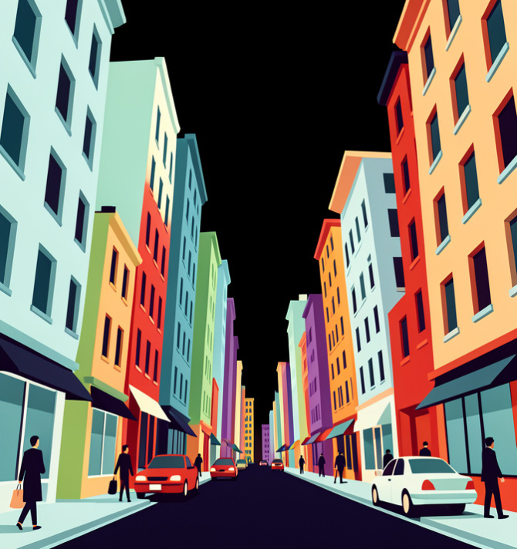
Why the Sharp Shapes?
Knuttel was inspired by Expressionism. This is a type of art where the artist shows feelings rather than just painting what they see.
By making shapes sharp and colours bright, he makes his paintings feel full of energy and drama.
🔑
Key point
Art doesn't have to look like a photo to be amazing. Sometimes, changing things makes them more interesting!

Slide 10
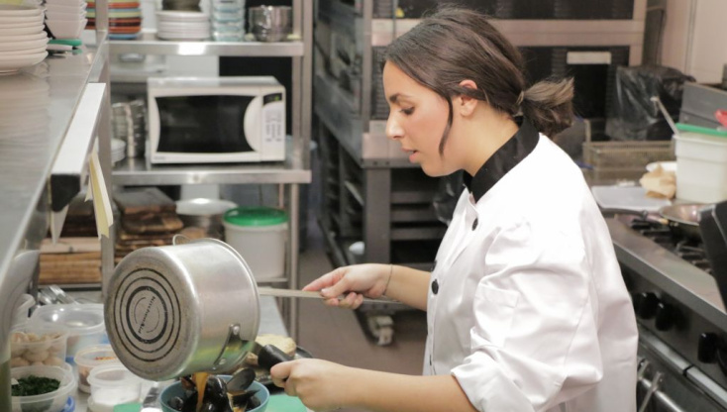

Knuttel's Style vs Real Life
Real Life
Soft edges
Shaded colours
Natural shapes
Knuttel Style
Hard black edges
Flat, solid colours
Pointy, sharp shapes

Slide 11

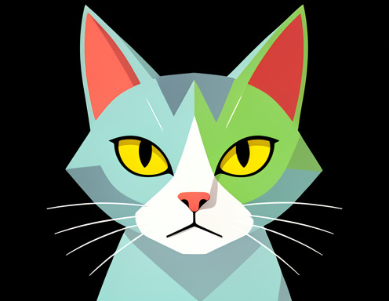
Be the Art Critic
Look at these two ways of painting. Which style do you like more? Do you think the 'Knuttel style' makes the characters look happy, angry, or mysterious?

Slide 12
Be the Art Critic
✅​
You might have said...
Sharp shapes can make people look serious or grumpy.
Bright colours make the paintings feel loud and exciting.
Big eyes help us feel the character's emotions.
Preference: some like realism, some like Knuttel's style!

Slide 13
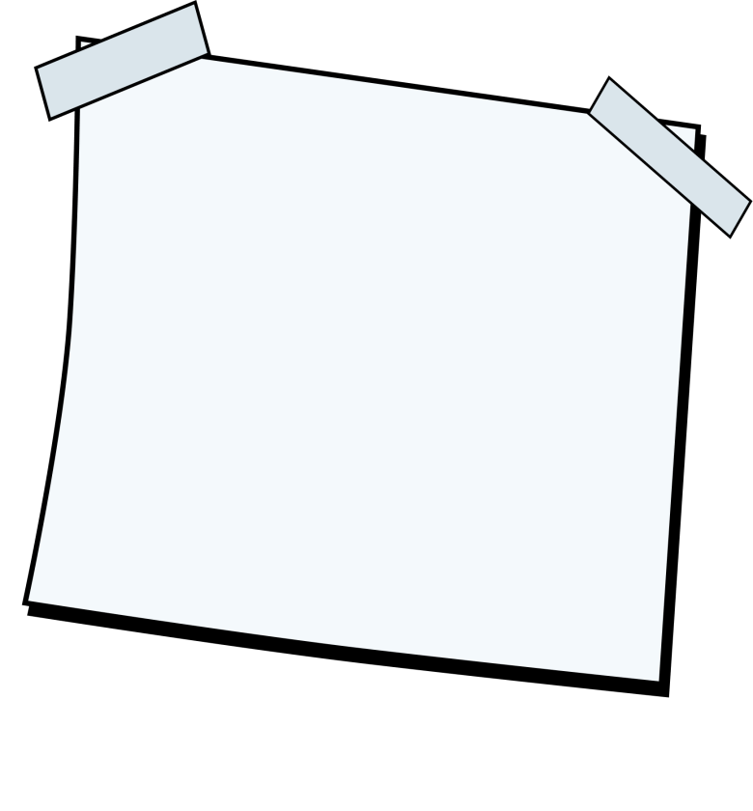
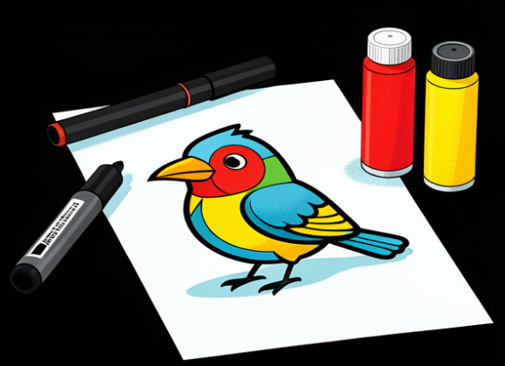
Create Your Own Knuttel Bird
It's time to be the artist! Draw a bird with a huge, pointed beak and two massive round eyes. Use a thick black marker for the edges and fill it in with the brightest colours you have!
What you'll need: 🎨​ 🖌️​
Paper, A black marker, Bright crayons or paints

