Slide 1
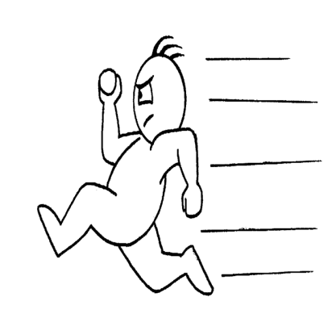
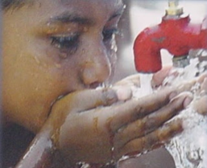
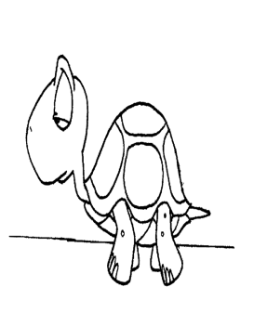
OPPOSITES

Slide 2
SLOW
FAST

Slide 5
LIGHT
HEAVY

Slide 6
LOW
HIGH - LOUD

Slide 7
WIDE
NARROW

Slide 8
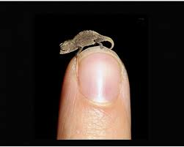
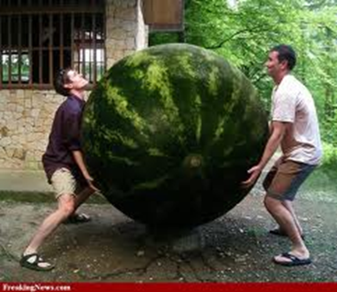
HUGE
TINY

Slide 9
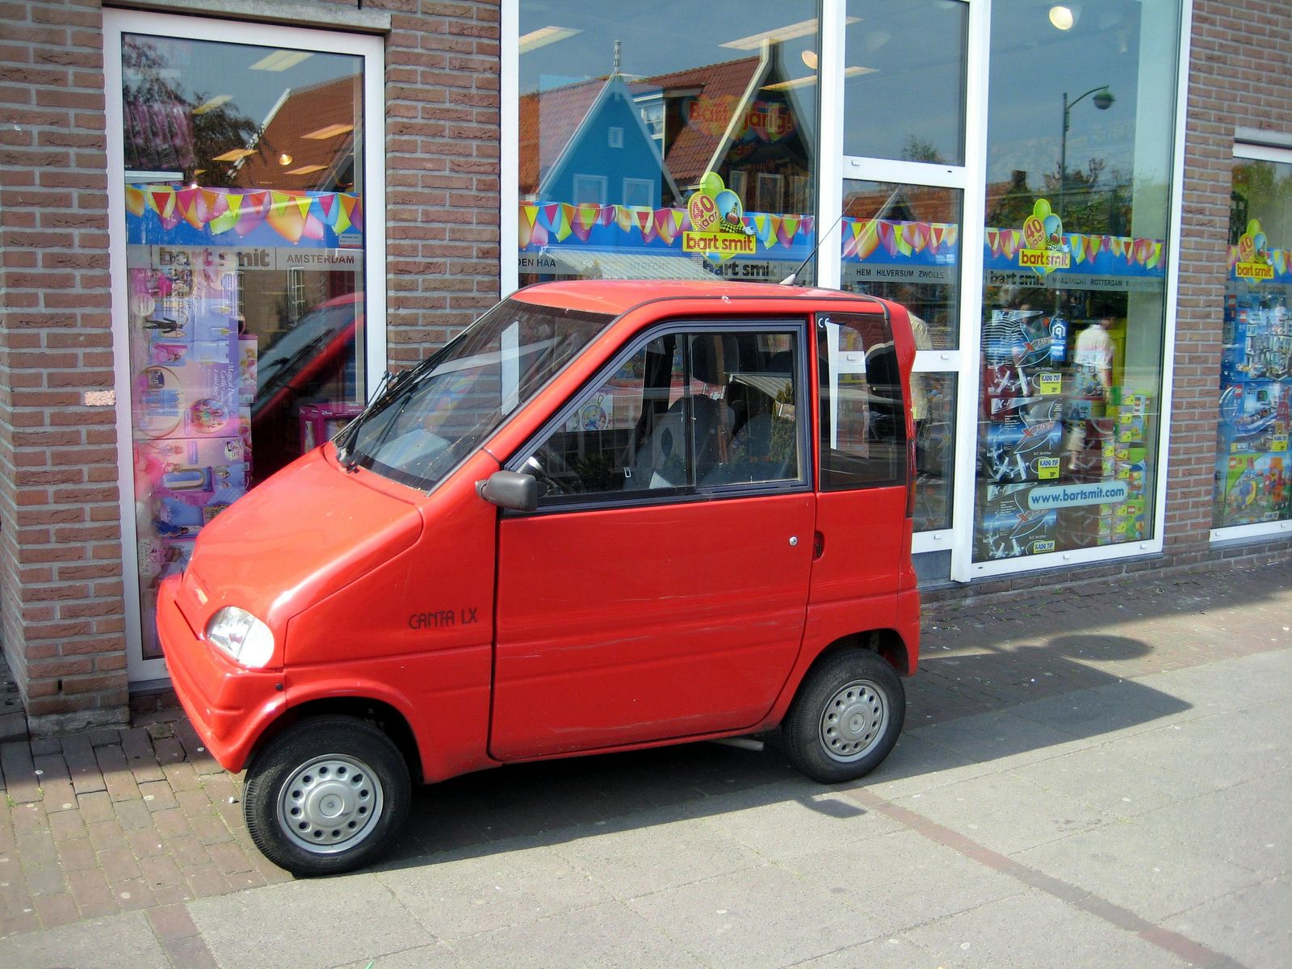
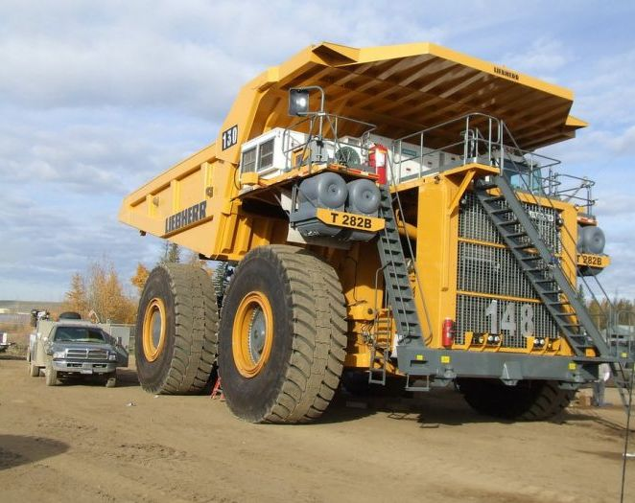
BIG
SMALL

Slide 10
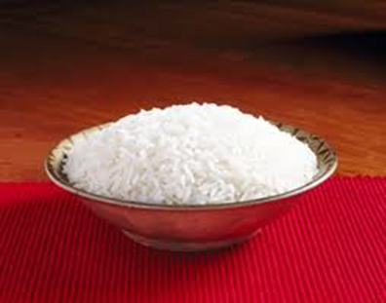
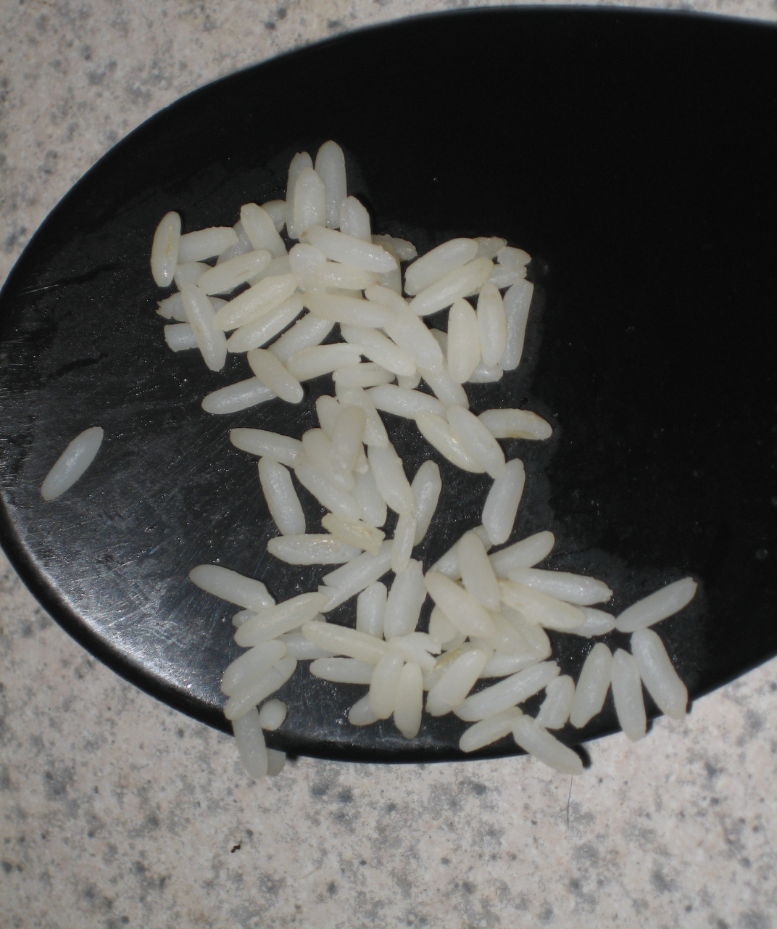
LITTLE
MUCH

Slide 11
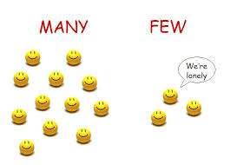

Slide 12
PLENTY
SPARSE

Slide 14
THIN
THICK

