Slide 1
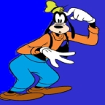
Are you ready for the test?

Slide 2
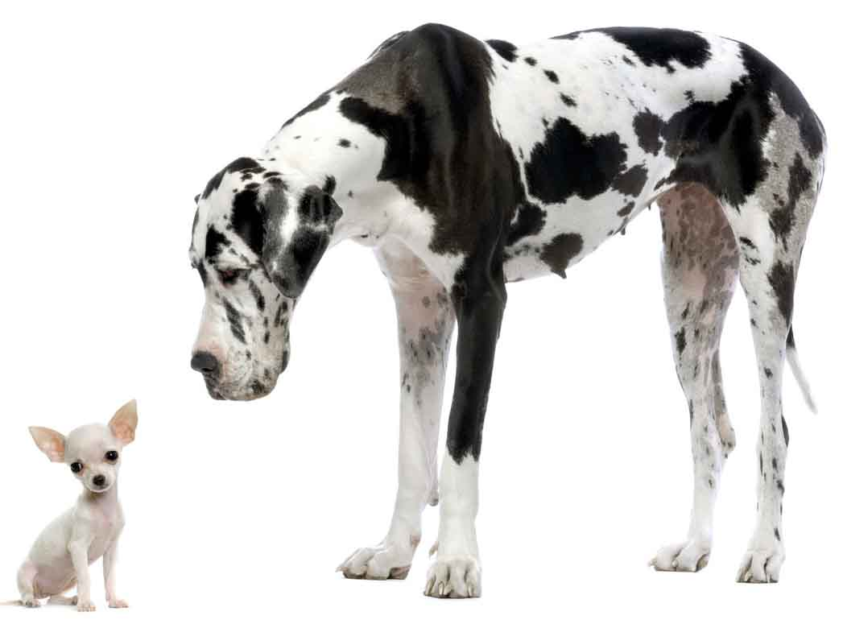
Opposites 1
Big or small?

Slide 3
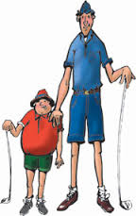
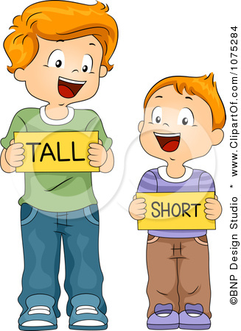
Opposites 2
Tall or short?

Slide 4
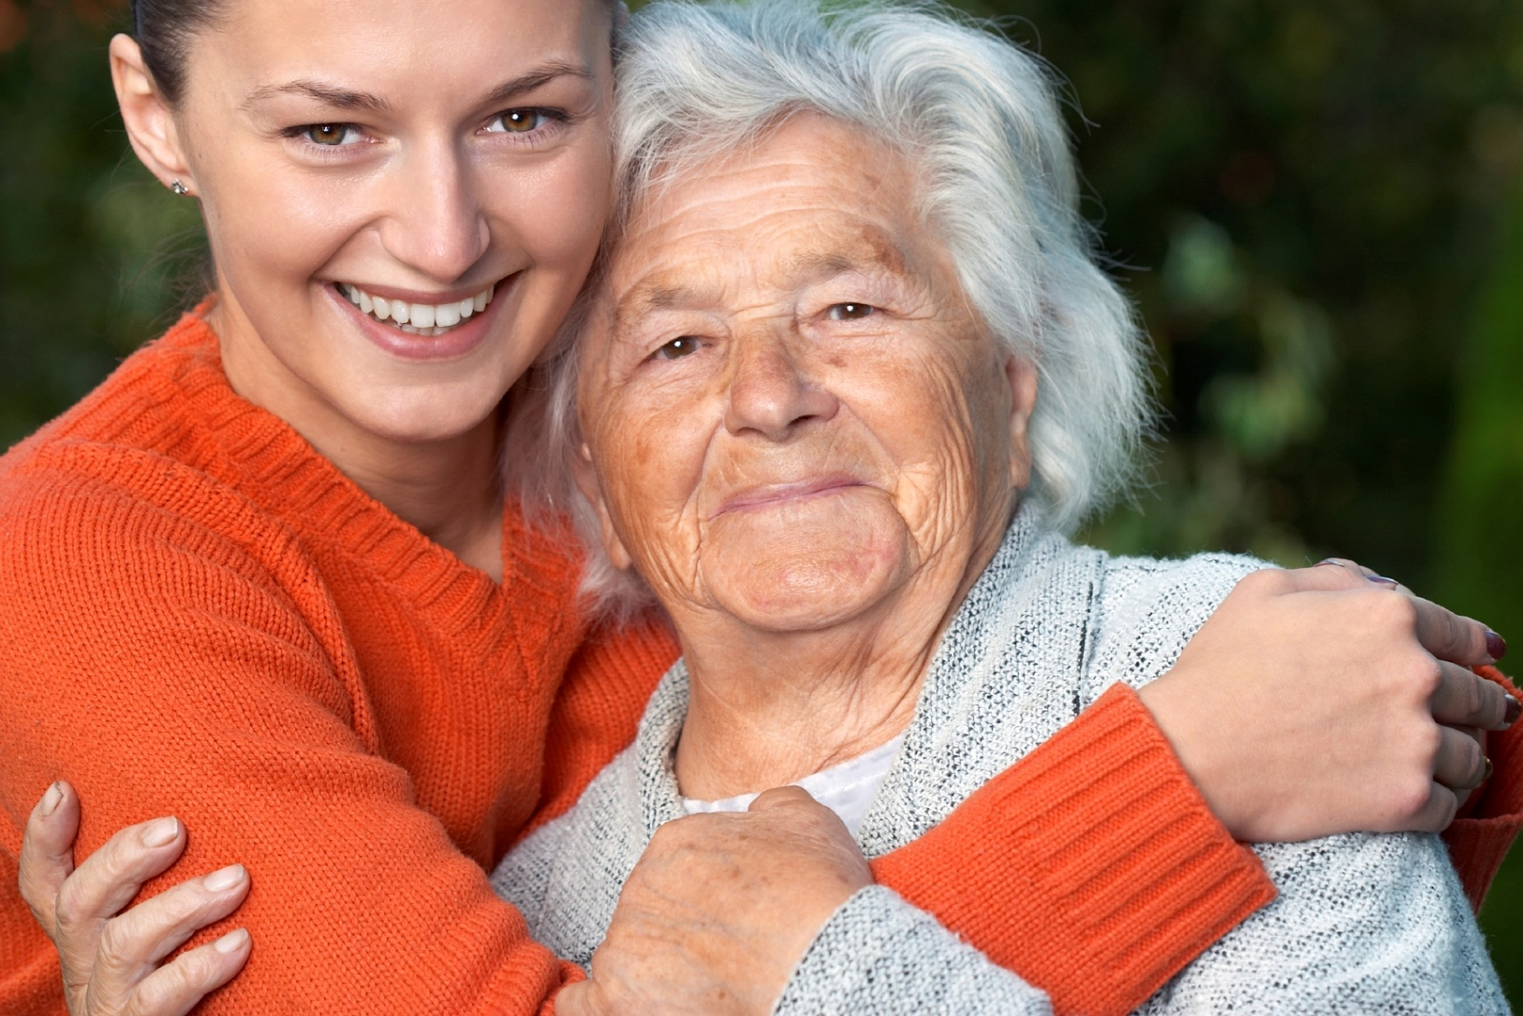
Opposites 3
Young or old?

Slide 5
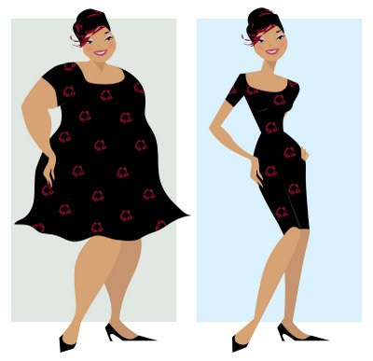
Opposites 4
Thin or fat?

Slide 6
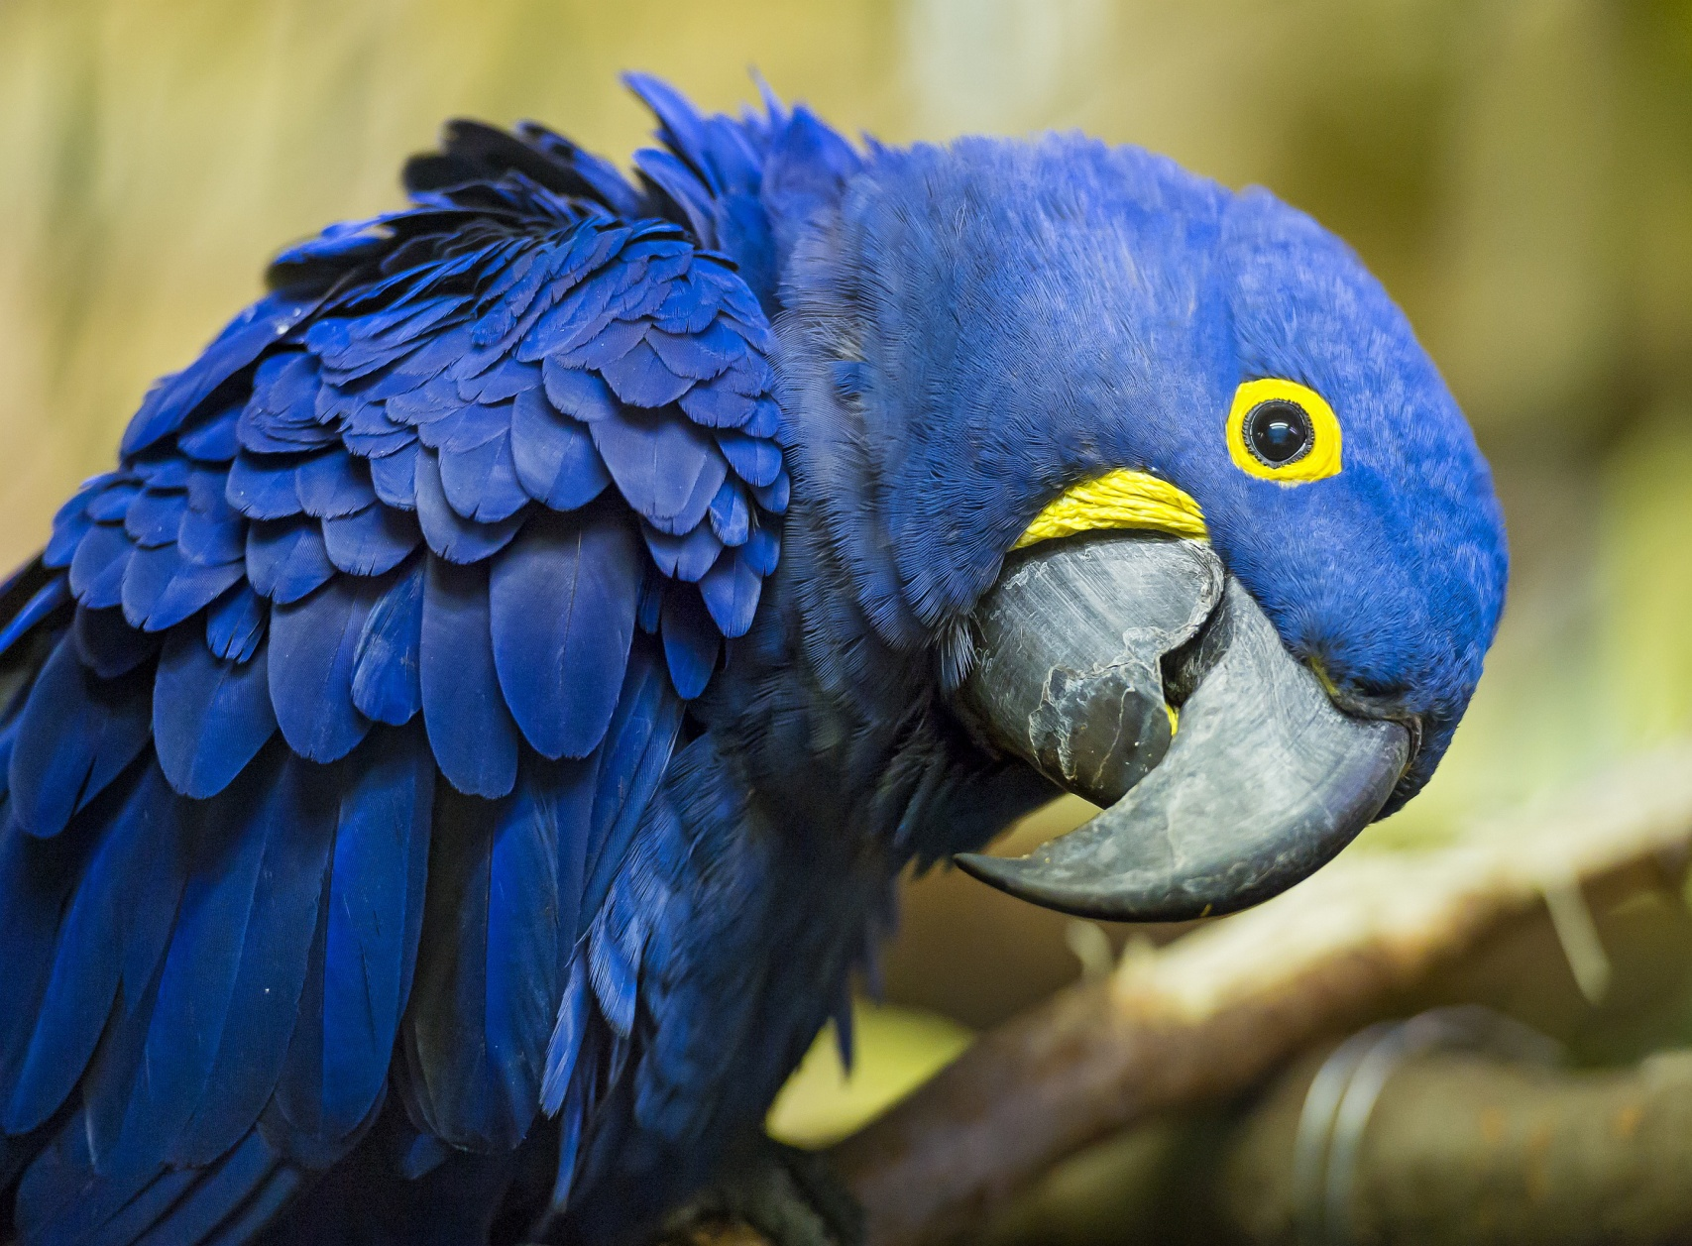
COLOURS!
A blue parrot.

Slide 7
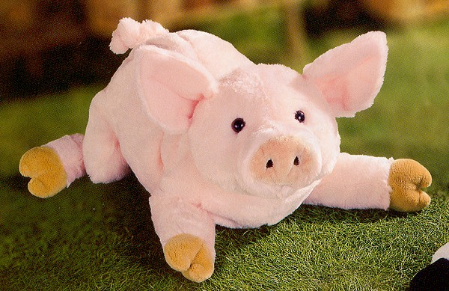
COLOURS!
A pink pig.

Slide 8
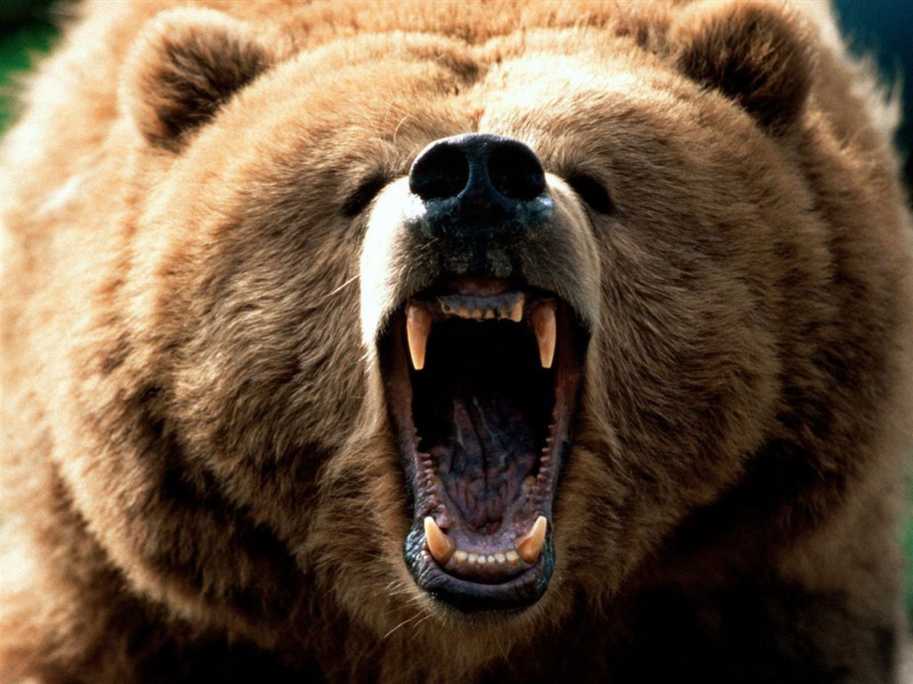
COLOURS!
A brown bear.

Slide 9
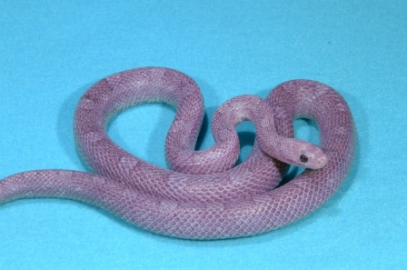
COLOURS!
A purple snake.

Slide 10
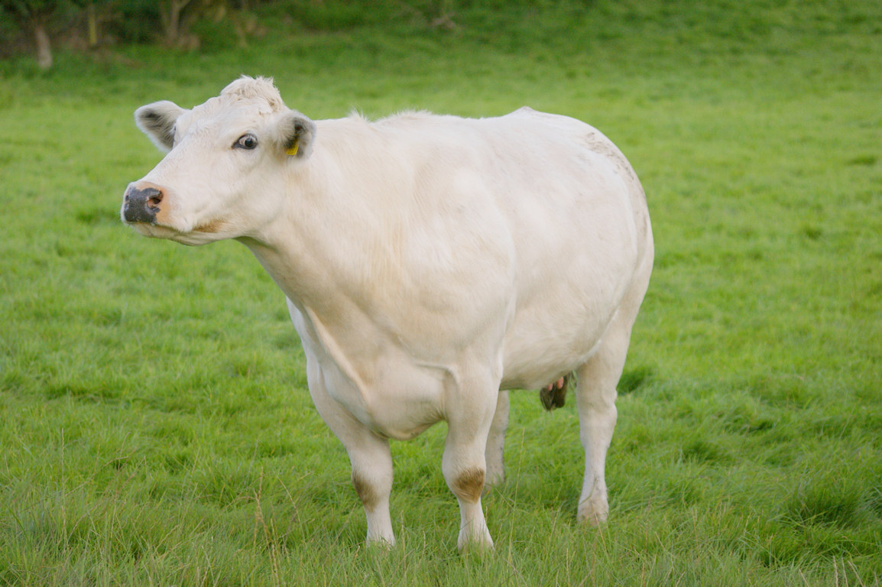
COLOURS!
A white cow.

Slide 11
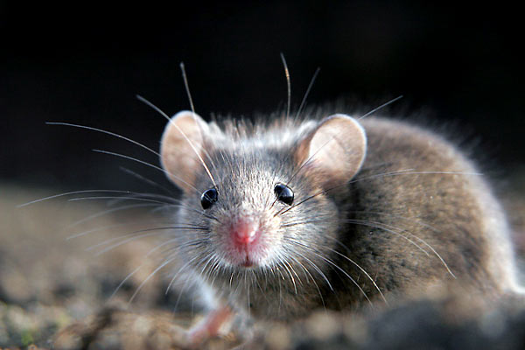
COLOURS!
A grey mouse.

Slide 12
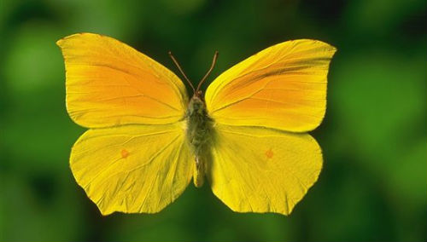
COLOURS!
A yellow butterfly.

Slide 13
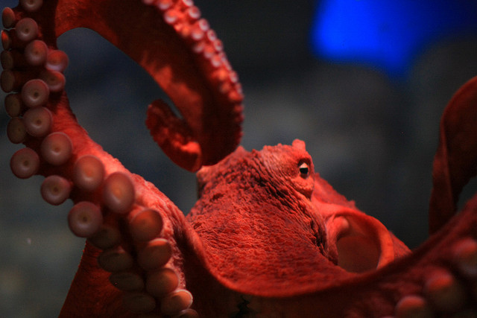
COLOURS!
A red octopus.

Slide 14
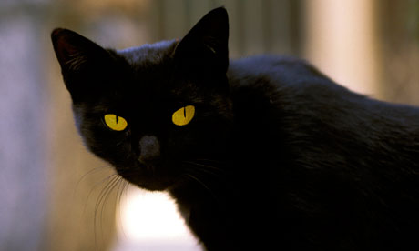
COLOURS!
A black cat.

Slide 15
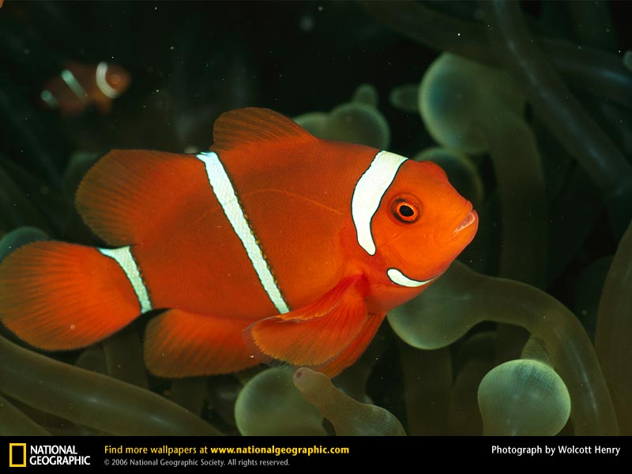
COLOURS!
An orange fish.

Slide 16
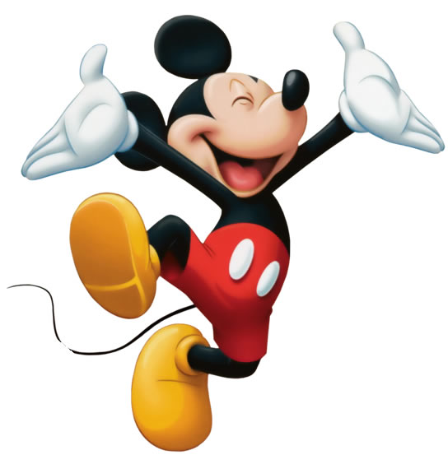
FEELINGS!
He is happy!

Slide 17
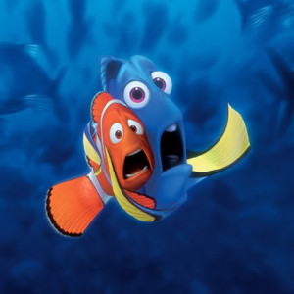
FEELINGS!
They are scared.

Slide 18
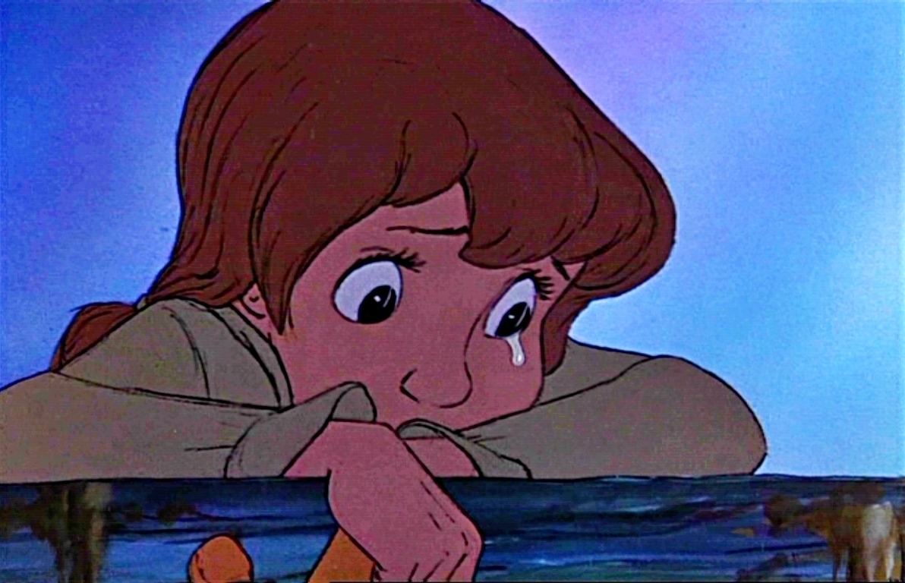
FEELINGS!
She is sad.

Slide 19
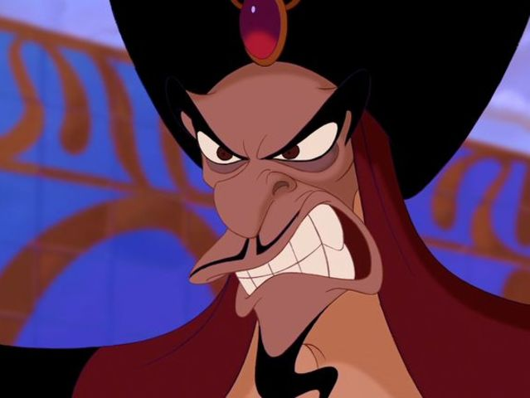
FEELINGS!
He is angry!

Slide 20
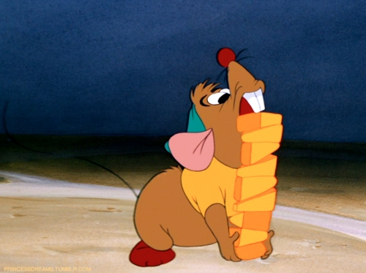
FEELINGS!
He is hungry!

Slide 21
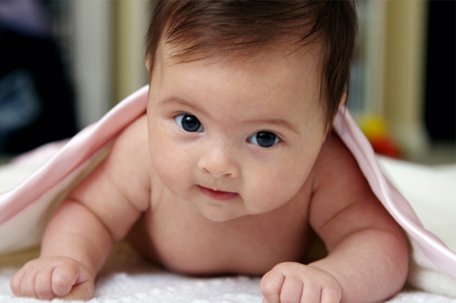
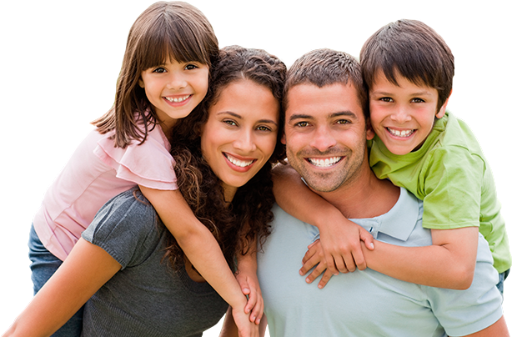
FAMILY!
Baby.
Sister, mummy, daddy, brother.

Slide 22
Can you say the sentence?
She is a dancer.

Slide 23
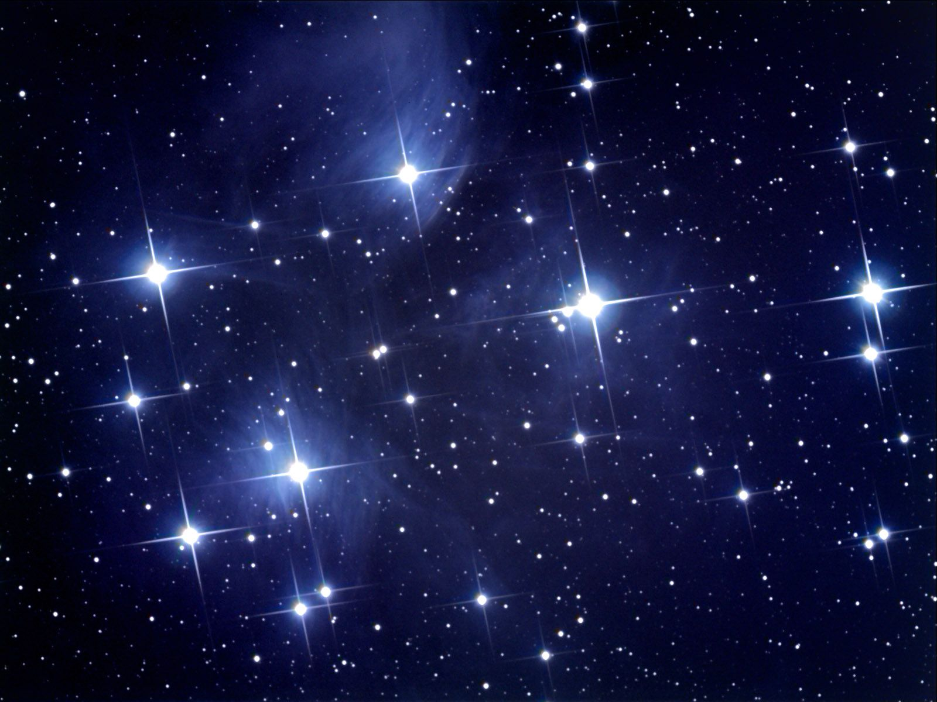
Can you say the sentence?
They are stars.

Slide 24
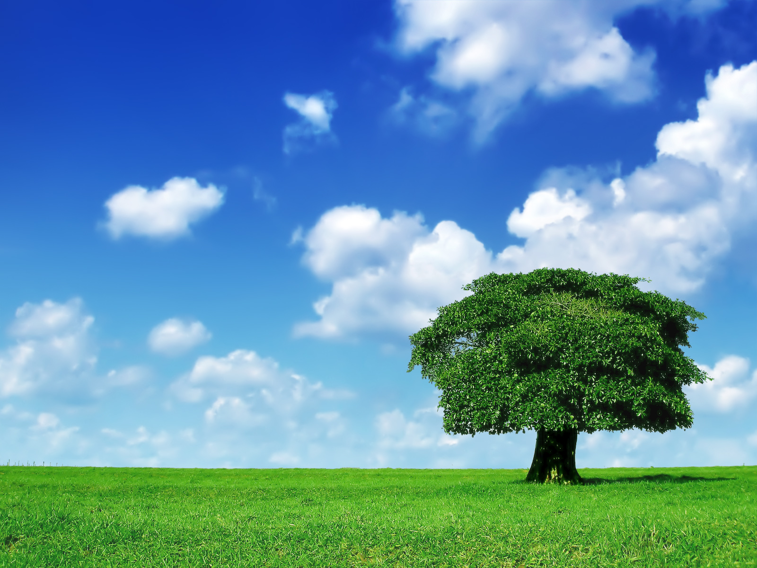
Can you say the sentence?
It is a tree.

Slide 25
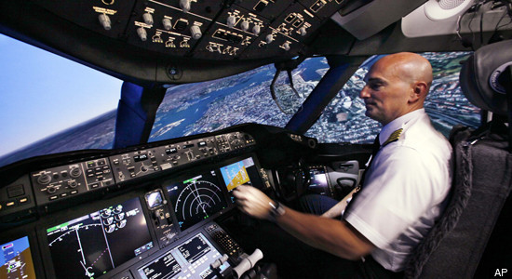
Can you say the sentence?
He is a pilot.

Slide 26
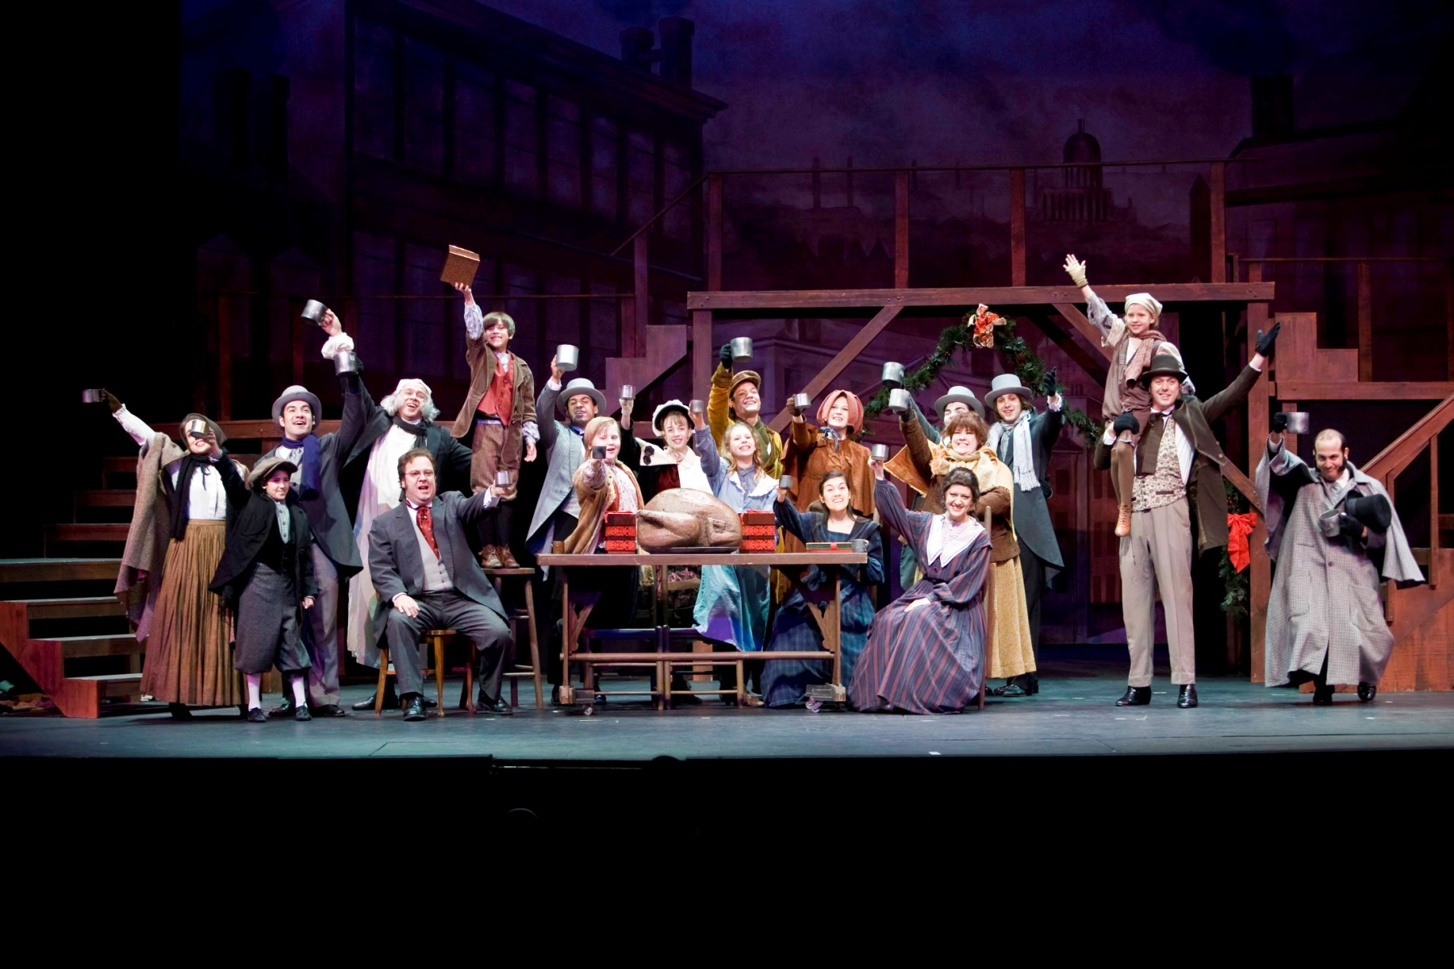
Can you say the sentence?
They are actors.

Slide 27
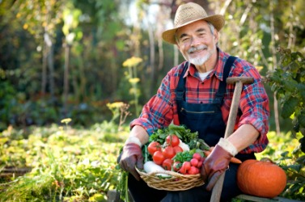
Is he a teacher?
Is he a farmer?

Slide 28
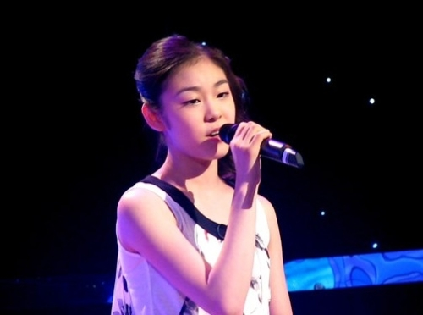
Is she a police officer?
Is she a singer?

Slide 29
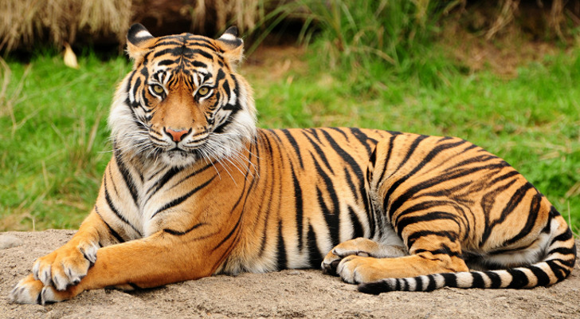
Is it a lion?
Is it an elephant?
Is it a tiger?

