Slide 1
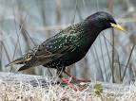
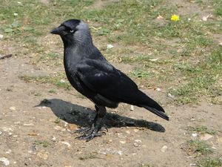
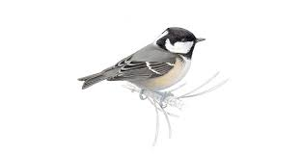
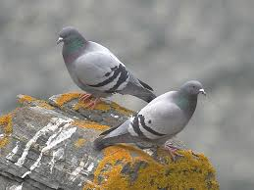
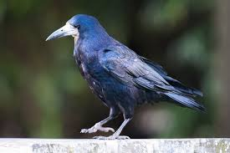
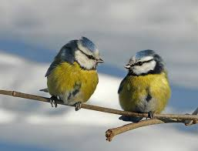
Birds in my garden

Slide 2
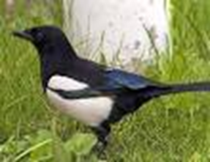
Magpie Pica Pica Snag breac
Length = 44-48cm
Wingspan = 55-56cm
Diet: Food such as seed, fruit, eggs and chicks
Average Lifespan: 5 years
Confusion species: None
Nesting Season: Early April to early May
Voice: Harsh chakk-kackk-kackk
Magpies are protected native species in Australia so it is illegal to kill or harm them.

Slide 3
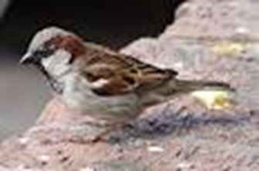
House Sparrow Passer domesticus Gealbhan binne
Length = 15cm
Wingspan = 23-24cm
Diet: Seeds, berries, nestlings fed insects
Average Lifespan: 3 years
Confusion species: Tree sparrow and female chaffinch
Nesting Season: Late March to mid July
Voice: Loud cheep
If a house sparrow builds a nest in your house it is said to be good luck

Slide 4
Starling Sturnus vulgaris Druid
Length = 21cm
Wingspan = 39-40cm
Diet: Mainly insects, berries and peanuts
Average Lifespan: 5 years
Confusion Species: Blackbird
Nesting Season: Early April to end of May
Voice: Expert mimics and can copy other birds and sounds such as whistles and doorbells
Each Winter Irish starlings are joined by other birds from Britain, Scandinavia, Germany, Poland and Russia. In severe continental Winters as many as 6 to 8 may million spend the Winter here

Slide 5
Jackdaw Corvus monedula Cág
Length = 33cm
Wingspan = 69-70cm
Diet: Food such as insects, seeds and kitchen scraps
Average Lifespan: 5 years
Confusion species: Rook especially young birds
Nesting season: Mid March to mid April
Voice: Harsh keyaak or kewkaw
More common in towns and cities but can be seen anywhere

Slide 6
Coal Tit Parus ater Meantán dubh
Length = 11-12cm
Wingspan = 18-19cm
Diet: Insects and spiders but also seeds in Winter
Average Lifespan: 2 years
Confusion species: Blue tit and great tit
Nesting Season: Late April and May
Voice: Very high su-ee-ou, zit-zit-zit, su-ee-ou
A bird watcher once put out 250g of whole peanuts on a bird table only to find that a coal tit had removed the lot in less than an hour, hiding the nuts in cracks in a nearby wall

Slide 7
Blue Tit Parus caeruleus Meantán gorm
Length = 11-12cm
Wingspan = 17-18
Diet: Insects and spiders, also berries, fruit and seeds in Winter
Average Lifespan: 3 years
Confusion species: Great tit and coal tit
Nesting season Mid April to mid May
Voice: A very high pfit-pfit-che-ha-ah-ah and a lower chur
Blue tits are very social birds. They can be spotted in flocks of up to 20 birds and are often seen feeding alongside other bird species, including gold crests and great tits

Slide 8
Feral Pigeon Columba livia Colm aille
Length = 31-33cm
*8
Wingspan = 65-67cm
Diet: Usually seeds, bread and kitchen scraps
Average Lifespan: 3 years
Confusion species: young wood pigeons
Nesting season: March to September
Voice: A variety of soft cooing sounds
Pigeons are said to be one the most intelligent birds on the planet and able to undertake tasks previously thought to be the sole preserve for humans and primates… The pigeon can also recognise all 26 letters of the english alphabet

Slide 9
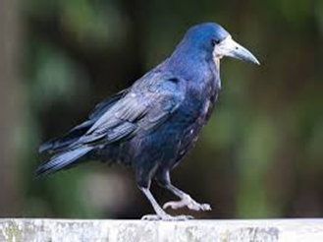
Rook Corvus frugilegus Préachán
Length = 42-47cm
Wingspan = 89-90cm
Diet: Very varied mainly beetles, earthworms, carrion and grain
Average Lifespan: 5 years
Confusion species: Raven and young jackdaws
Nesting season: Late March to early May
Voice: Harsh kaw
A group of rooks are called a rookerie

Slide 10
Sightings of birds (according to ‘Ireland’s garden birds’ 2011edition)
Bird | Rank in garden bird survey | Seen in % gardens
Blue tit | 2 | 98%
Magpie | 4 | 93%
Coal tit | 7 | 84%
House sparrow | 10 | 82%
Starling | 12 | 78%
Jackdaw | 15 | 68%
Rook | 17 | 61%
Feral pigeon | 29 | 21%

