Slide 2
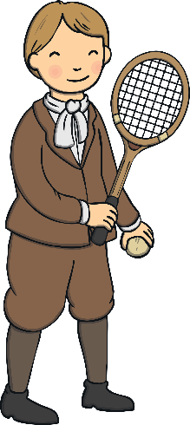
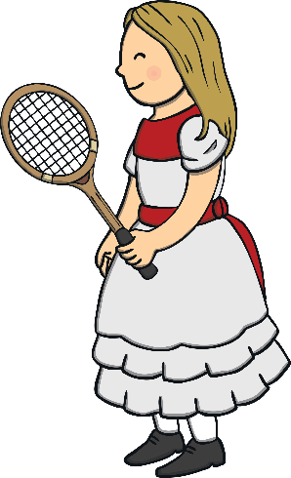
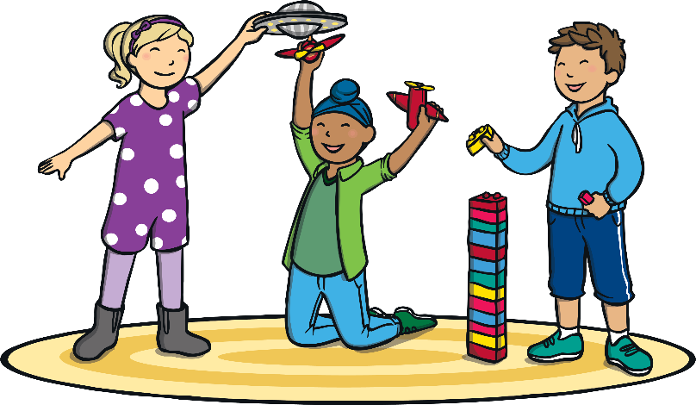
Can you write two sentences to describe these pictures using simple past tense and simple present tense?
Show answer
One sentence must use a past tense verb and one must use a present tense verb. For example: Children played with old-fashioned toys in the past. We play with toys that are more modern now.

Slide 3
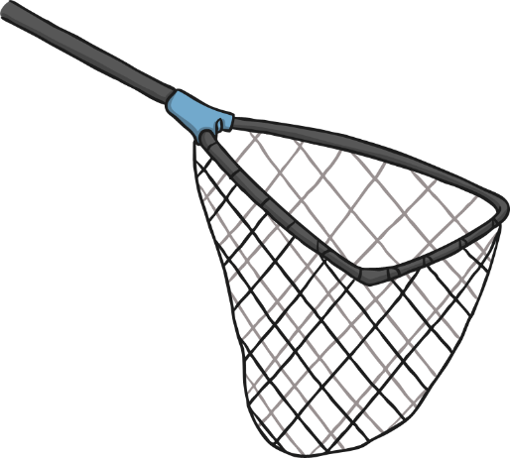
Can you catch the butterflies needed to spell the verb in this sentence? Is this sentence written in simple past or present tense? Look at the verb to help you decide.
I ______ to bring my P.E. kit to school so I can’t do P.E.
f
o
r
g
o
t
k
o
f
t
r
g
o
e
n
Show answer
The missing verb is ‘forgot’. This sentence is written in simple past tense.
Incorrect letter!
Incorrect letter!
Incorrect letter!

Slide 4
Can you catch the butterflies needed to spell the verb in this sentence? Is this sentence written in simple past or present tense? Look at the verb to help you decide.
The roses in my garden ____.
g
r
o
w
t
o
w
h
g
r
f
e
n
Show answer
The missing verb is ‘grow’. This sentence is written in simple present tense.
Incorrect letter!
Incorrect letter!
Incorrect letter!
Incorrect letter!
Incorrect letter!

Slide 5
Can you catch the butterflies needed to spell the verb in this sentence? Is this sentence written in simple past or present tense? Look at the verb to help you decide.
When the witch cast a spell on him, he ______ a slimy frog.
b
e
c
a
m
e
a
w
e
m
b
e
o
c
n
Show answer
The missing verb is ‘became’. This sentence is written in simple past tense.
Incorrect letter!
Incorrect letter!
Incorrect letter!

Slide 6
Can you catch the butterflies needed to spell the verb in this sentence? Is this sentence written in simple past or present tense? Look at the verb to help you decide.
This is my party so I get to ______ the party games that we play!
c
h
o
o
s
e
h
o
s
r
c
l
o
e
n
Show answer
Incorrect letter!
The missing verb is ‘choose’. This sentence is written in simple present tense.
Incorrect letter!
Incorrect letter!

Slide 7
Can you catch the butterflies needed to spell the verb in this sentence? Is this sentence written in simple past or present tense? Look at the verb to help you decide.
b
r
o
k
e
Mandeep _____ her leg so she can’t take part in the race.
s
f
d
k
b
r
o
e
t
Show answer
The missing verb is ‘broke’. This sentence is written in simple present tense.
Incorrect letter!
Incorrect letter!
Incorrect letter!
Incorrect letter!

Slide 8
Are these sentences written in the simple past or present tense? Click the old book or the modern robot to choose which you think it is. How do you know?
I ride my bike around the field.
past
present
I knew the answer to the question.
past
present
I wear my sunglasses in the summer.
past
present

Slide 9
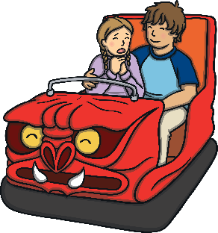
Spin the spinners! Write a sentence about the topic selected by the first spinner in the tense selected by the second spinner. If you spin ? then try to write two sentences using both tenses!
ice cream
birthdays
simple present tense
simple past tense
brothers and sisters
where you live
?
spin!
spin again!
and again!
one more time!

Slide 10
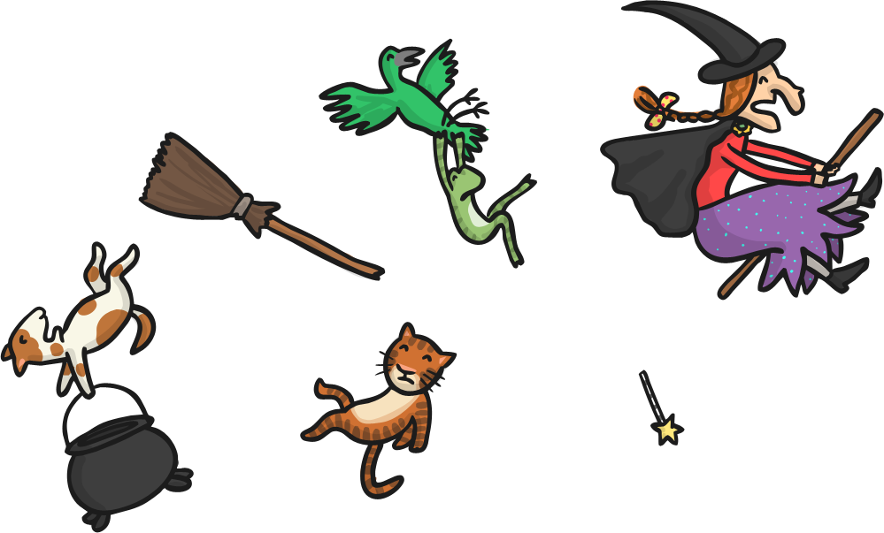
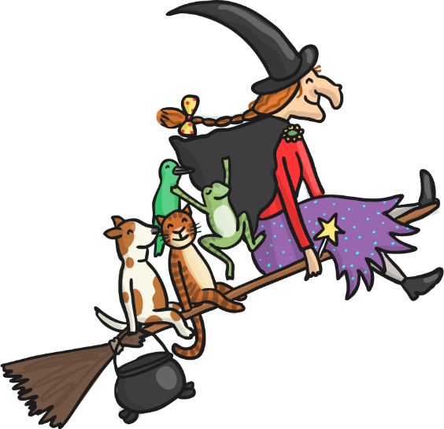
Can you write two sentences to describe these pictures using the simple past tense and the simple present tense?
Show answer
One sentence must use a past tense verb and one must use a present tense verb. For example: All the animals ride on the broom. The animals fell off the broom.

Slide 11
This sentence has been mixed up. Can you put it in the right order? Do you think it is simple present or simple past tense?
school the Maya bus yesterday. caught to
Show answer
Maya caught the bus to school yesterday.
This is written in the simple past tense.
challenge
Can you write your own mixed-up sentence for your partner? Can they say if it is in simple past or present tense?

Slide 12
This sentence has been mixed up. Can you put it in the right order? Do you think it is simple present or simple past tense?
bolognese. cooks Dad delicious spaghetti
Show answer
Dad cooks delicious spaghetti bolognese.
This is written in the simple present tense.
challenge
Can you write your own mixed-up sentence for your partner? Can they say if it is in simple past or present tense?

Slide 13
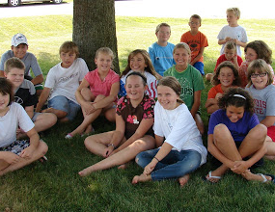
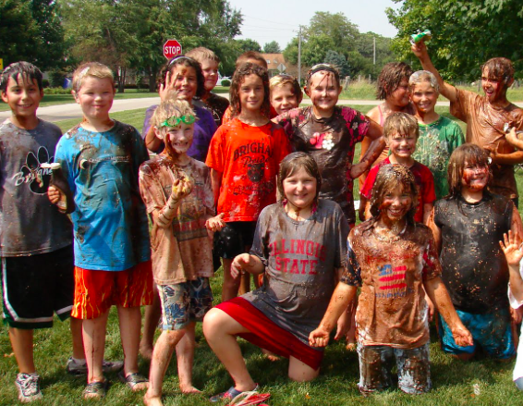
Can you write two sentences to describe these pictures using the simple past tense and the simple present tense?
Show answer
One sentence must use a past tense verb and one must use a present tense verb. For example: The children were nice and clean before the food fight. They are very dirty after the food fight.

Slide 14
Can you sort the sentences into simple past and simple present tense? Put the simple past tense sentences into the rubbish bin and the simple present tense sentences into the treasure chest.
Can you think of a sentence of your own that you could put into the treasure chest and the rubbish bin?
Simple Present Tense
Simple Past Tense
I had fun at the fair.
I watched the parade go by.
Emily solved the puzzle.
She plays the trombone.
He wants to go to ballet class.
Hamza spells words easily.

Slide 15
Can you click on the letters in this verb to change this sentence from simple present tense to simple past tense? What do you think each letter will change to?
She to the supermarket with her mum.
g
w
o
e
e
n
s
t
Show answer
She went to the supermarket with her mum.

Slide 16
Can you click on the letters in this verb to change this sentence ffrom simple past tense to simple present tense? What do you think each letter will change to?
d
d
e
e
c
c
i
i
d
d
e
e
d
s
He to walk to the park by himself.
Show answer
He decides to walk to the park by himself.

Slide 17
Can you click on the letters in this verb to change this sentence from simple present tense to simple past tense? What do you think each letter will change to?
r
e
a
d
I my favourite poem aloud.
Show answer
I read my favourite poem out loud. Some verbs, like read, change their pronunciation but not their spelling when they change from present to past tense.

Slide 18
Which verb would you choose to make these into simple past tense sentences?
Sentence
Which Verb? (click)
I brought my pet puppy to school.
I my pet puppy to school.
brought
brought
bring
bring
My puppy bit the teacher!
My puppy the teacher!
bit
bit
bites
bites
The teacher met with my mum and dad.
meets
The teacher with my mum and dad.
meets
met
met
Show answer

Slide 19
Split into two teams. Take it in turns to click on two cards. If you find the same sentence written in simple past tense and simple present tense then you score a point for your team. Whichever team has found the most pairs at the end of the game wins.
I went up the stairs to my bedroom.
?
She forgets to buy the flour.
?
He left his friend’s house in a sulk.
?
I collect football cards.
?
Zara is in a fantastic mood today.
?
I go up the stairs to my bedroom.
?
I collected football cards.
?
Zara was in a fantastic mood today.
?
You brought me cookies every day.
?
You bring me cookies every day.
?
She forgot to buy the flour.
?
He leaves his friend’s house in a sulk.
?
(Click the cards again to turn them back over if the words are not all found in that turn.)

