Slide 1
18th March 2020

Slide 2
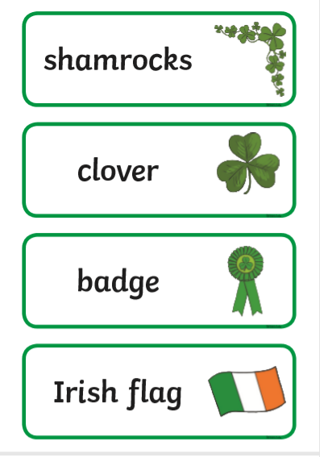
Oral Language

Slide 3
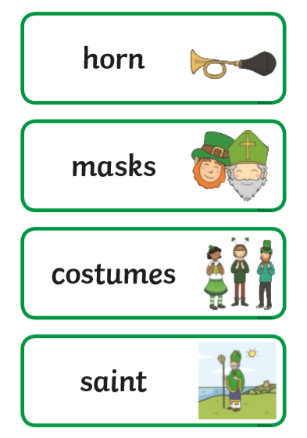
Oral Language

Slide 4
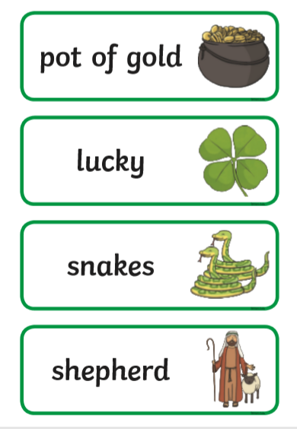
Oral Language
Take turns putting these words into sentences.

Slide 5
Music / Dance
https://youtu.be/BSeWQwQmrR4

Slide 6
Handwriting / dictation
https://youtu.be/OzzyBmi8-6E
This video demonstrates the correct teaching of letter formation.
The first six letters all “go around
like c first”.
Ask your child’s their spellings
from their jolly phonics
copy. Revision of these words is
Very important.

Slide 7
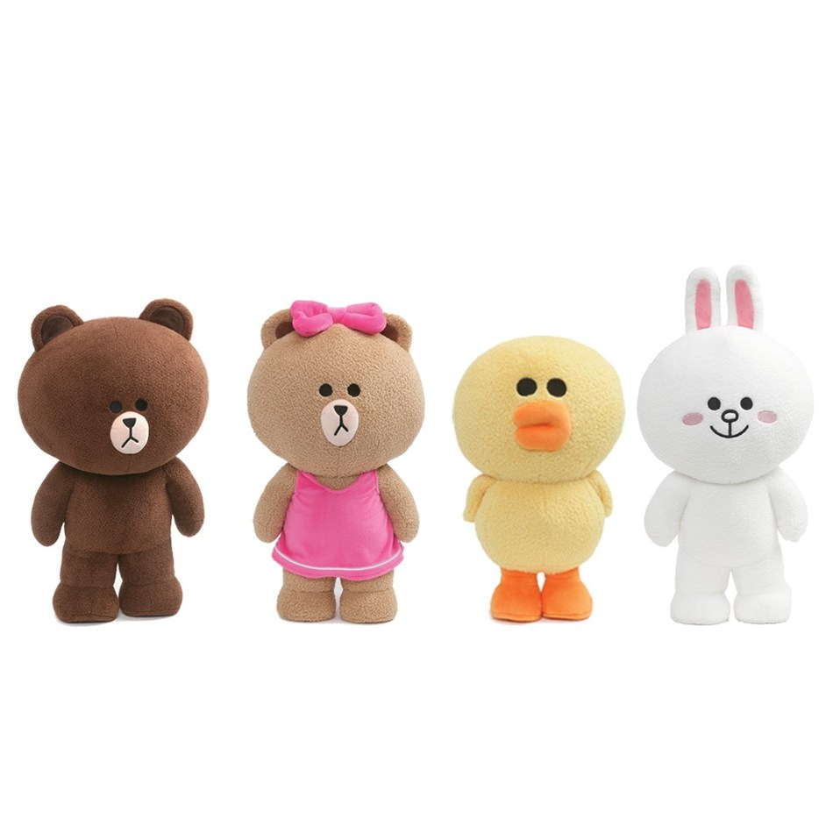
Maths
Play “magic number” with your child. This game can be played with teddies, dolls and superheroes.
E.g. Start at 28...29...30...31 (31 is the magic number; you have to sit down)
29
31
28
30

Slide 8
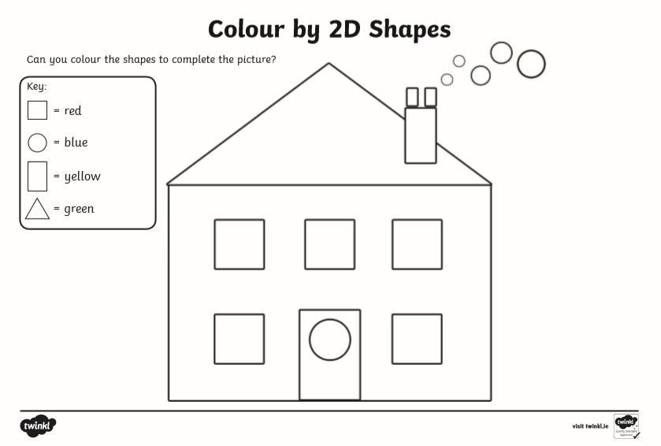
Maths
Draw this picture. Use objects to help you draw.

Slide 9
Length (A2)
Order toys according to length.
Order toys according to height.
Order toys according to width.
Compare!

